Slide 1


Configuration Management
[ Fundamentals ]
Presenter
Mohammad Anees Alam
Notes:
1

Slide 2





Topics for today!
Understanding Configuration management
Deep dive into Configuration drift
Popular Configuration Management Tools
Setting up Ansible tool
Hands-on Activity with Nginx
Notes:
2

Slide 3




The Traditional Manual Setup
SSH into each server
Manually connect to every machine in your infrastructure.
Install dependencies
Run commands like apt-get install for each package.
Configure servers
Edit configuration files like nginx.conf on each machine.
Copy scripts
Transfer files between machines using scp or shared drives.
Notes:
3

Slide 4

Problems with Manual Configuration
Human Error
Manual processes are prone to mistakes that can cause system failures.
Inconsistency
Hard to repeat the same process consistently across multiple servers.
Time-Consuming
Setting up servers manually takes hours and creates stress.
No Version Control
Changes lack history or rollback capability when things go wrong.
Notes:
4

Slide 5




What Configuration Management Solves
Consistency
The same configuration applied to dev, staging, and production environments.
Speed
One script configures hundreds of servers in minutes.
Documentation as Code
Configuration becomes readable and version-controlled.
Testability
Easier to test infrastructure in test/stage environments.
Idempotency
5
Will maintain desired state even after re-applying the configs.
Notes:
5

Slide 6





Understanding Configuration Drift
Manual Hotfixes
Changes made under pressure in production environments.
Untracked Changes
Config files edited without documentation.
Different Patch Levels
Inconsistent OS patches or application versions.
Resulting Problems
Environment-specific bugs, security vulnerabilities, broken CI/CD pipelines.
Notes:
6

Slide 7



How CM Tools Helps
Detect and fix drift by enforcing a known configuration
Apply changes declaratively (not procedurally)
  Procedural: “Step-by-step instructions.”
  Declarative: “Tell the system what you want, not how to do it.”
Use inventory management to keep track of system states
List of resources + details like IP, environment etc.
Notes:
7

Slide 8
Declarative vs. Procedural Approach
Procedural (Manual Script)
Declarative (Ansible)
Inventory management
sudo apt update
sudo apt install nginx
sudo systemctl start nginx
sudo systemctl enable nginx
- name: Install and run NGINX
hosts: web
become: yes
tasks:
- name: Ensure nginx is installed
apt:
name: nginx
state: present
- name: Ensure nginx is running
service:
name: nginx
state: started
[web]
192.168.1.10
192.168.1.11
[db]
192.168.1.12
[prod:children]
web
db
Step-by-step instructions telling the system how to install NGINX.
You create an inventory file (ini) and use it with CM tool.
Just declaring the end state you want, Ansible figures out the steps.
  You can target specific groups ([web], [db], [prod])
  Ansible knows what to configure where
Notes:
8

Slide 9



Real-World Failure: Lack of CM
  A fintech startup deployed microservices across 10 servers.
  While 7 were configured using a shell script, the remaining 3 were manually set up under time pressure.
Open Port
One server had an exposed debug port, resulting in a security breach.
Launch Failure
Some microservices failed silently.
Logs generation failed
Log files were missing, making debugging difficult.
Notes:
9

Slide 10
Configuration Drift at a Food Delivery Service
Context:
You’re the DevOps engineer for an online food delivery platform that recently rolled out an important update across production servers.
Issue:
Soon after deployment, users start reporting bugs — but only from some servers.
After digging deeper, you find:
  Some servers were still running an older version of Python
  A few were missing critical environment variables
  Logging formats were inconsistent across instances
What went wrong?
Why do you think only some servers had problems?
What could have prevented this situation?
How would you solve this if you were the engineer?
Notes:
10

Slide 11





Key Benefits of Configuration Management
Consistency
Scalability
All environments look and behave the same, preventing "works on my machine" issues.
Easily replicate configurations across 1, 10, or 1,000 servers.
Disaster Recovery
Time-Saving
Rebuild failed systems automatically with the same settings.
Tasks that take hours manually can be done in minutes.
Notes:
11

Slide 12
Popular Configuration Management Tools
  They are 3 configuration tools that are widely used in the majority of the projects: Ansible, Puppet, Chef.
Tool
Language
Architecture
Best For
Server Required
Ansible
YAML
Agentless
Cloud & Quick setups
No
Puppet
Puppet DSL
Agent-based
Large enterprises
Yes
Chef
Ruby
Agent-based
Complex logic needs
Yes
Ansible is the most preferred CM tool of all because:
  Simple, Human-Readable YAML Syntax
  Fast Learning Curve
  Flexible & Versatile
  Smooth CI/CD Integration
Notes:
12

Slide 13
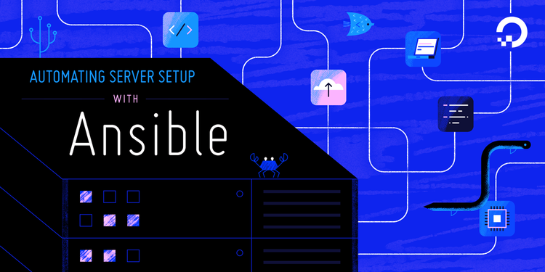
Setting up Ansible tool : Click Here
This Photo by Unknown Author is licensed under CC BY-SA-NC

